Slide 1
Spectral Graph Approximation
Clemens Damke
Intelligent Systems and Machine Learning Group
ISML Seminar, July 2019

Slide 2
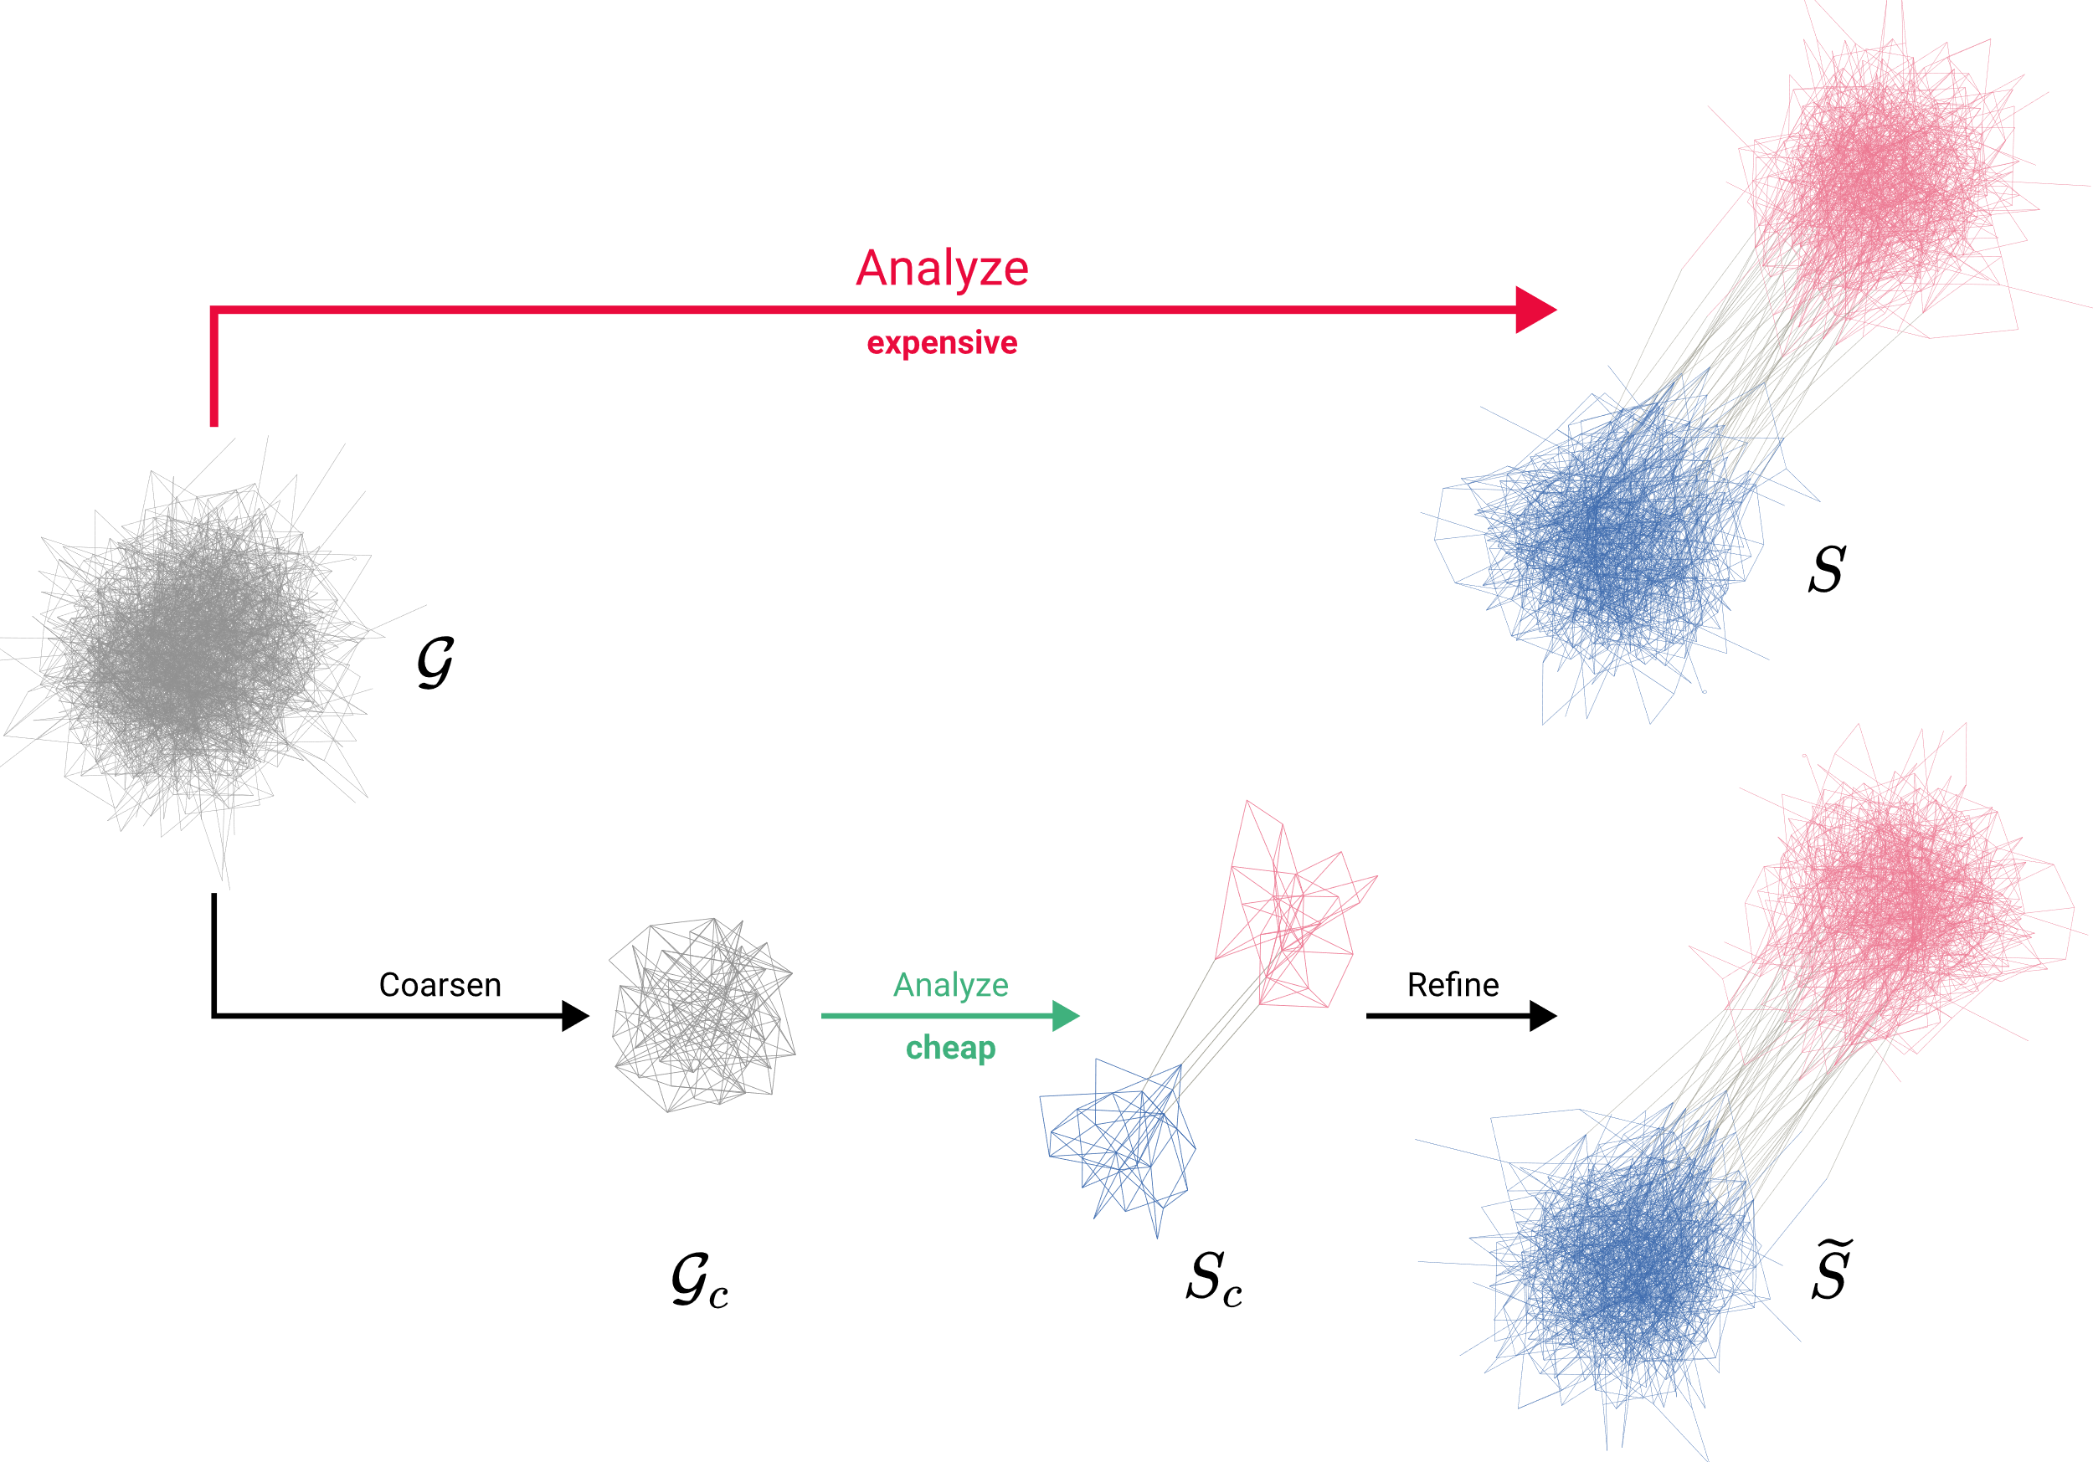
MOTIVATION

Slide 3
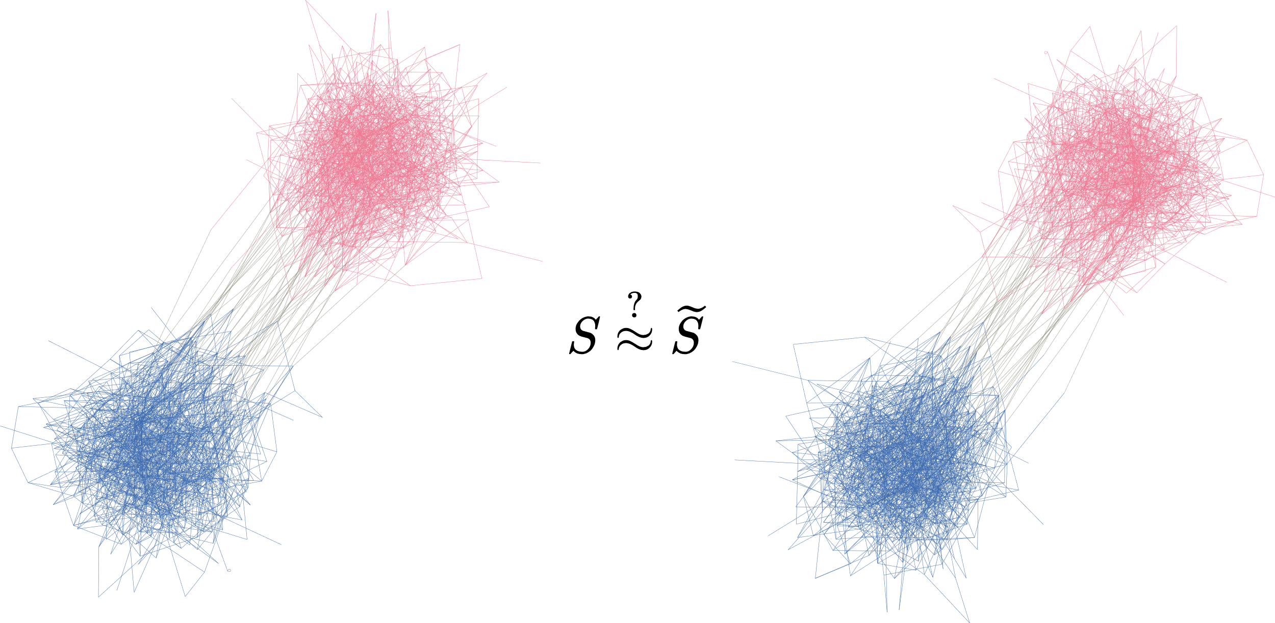
MOTIVATION
What is the effect of coarsening?

Slide 4
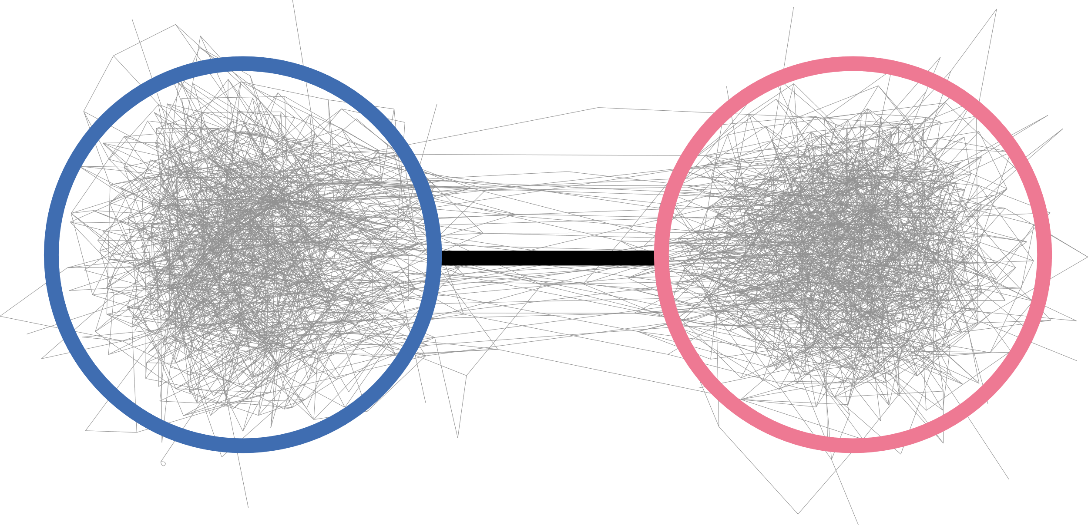
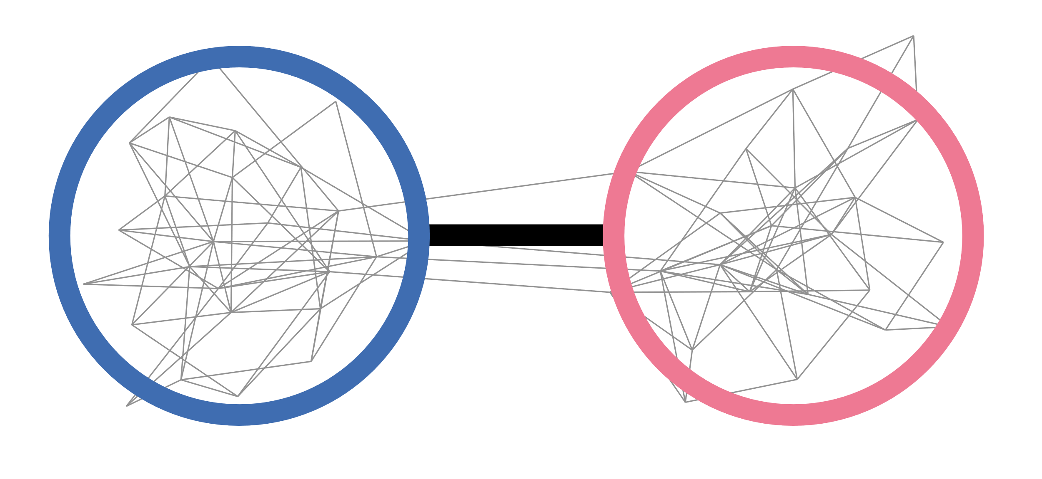
OVERVIEW
1. How to describe a graph‘s overall structure?
2. How to coarsen a graph?
3.
What is the effect of coarsening?

Slide 5
1. SPECTRAL GRAPH THEORY

Slide 6
OVERVIEW
1. How to describe a graph‘s overall structure?
2. How to coarsen a graph?
3.
What is the effect of coarsening?

Slide 7
OVERVIEW
1. How to describe a graph‘s overall structure?
2. How to coarsen a graph?
3.
What is the effect of coarsening?

